Slide 1
Data Structures and Algorithm
Course Code: CS-201
Topic: Singly Linked List Insertion and deletion

Slide 2
Goals for today
To study:
Singly Linked List
Insertion
Deletion

Slide 3
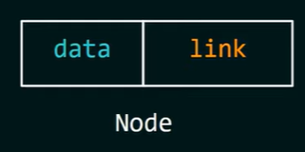
Creation of node
To create a linked list in the memory, use structure which is self referential structure.
In self referential structure one member of the structure is a pointer that points to the structure it self
struct node
{
int data; // any data type can be used
struct node *link; // this points to the structure itself
};
Notes:
Use <stdlib> for dynamic memory allocation

Slide 4
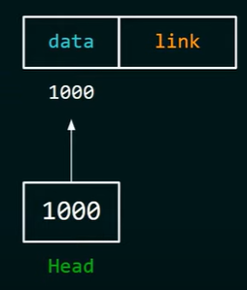
Creation and insertion of data in node
Int main()
{
struct node *head = NULL;
head = (struct node*)malloc(sizeof(struct node));
head->data = data;
head->link = NULL;
}
Notes:
Use <stdlib> for dynamic memory allocation
Head = new(struct node)

Slide 5
Insertion of an element into the linked list at various positions:
OPERATION ON SINGLE LINKED LIST
Insertion of node into a linked list requires a free node in which the information can be inserted and then the node can be inserted into the linked list.
Before header or at beginning.
At the end of list.
At the specified position.
Notes:
5

Slide 6
It is a list of free nodes in the memory. It contains unused memory cells and these memory cells can be used in future. It is also known as ‘List of Available Space’ or ‘Free Storage List’ or ‘Free Pool’. It is used along with linked list. Whenever a new node is to be inserted in the linked list, a free node is taken from the AVAIL List and is inserted in the linked list. Similarly, whenever a node is deleted from the linked list, it is inserted in the AVAIL List. So that it can be used in future.
Availability List or AVAIL List.
Notes:
6

Slide 7
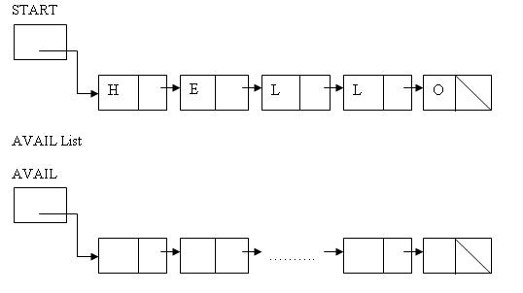
Availability List or AVAIL List.
Notes:
7

Slide 8
Overflow
Overflow and Underflow
Overflow happens at the time of insertion. If we have to insert new data into the data structure, but there is no free space i.e. availability list is empty, then this situation is called 'Overflow’.
Overflow will occur with our linked list when AVAIL = NULL and there is an insertion
Underflow
Refers to the situation where one wants to delete data from a data structure that is empty.
The situation is handled by printing the message UNDERFLOW
Observe that underflow will occur when our linked lists when START = NULL and there is a deletion
Notes:
8

Slide 9
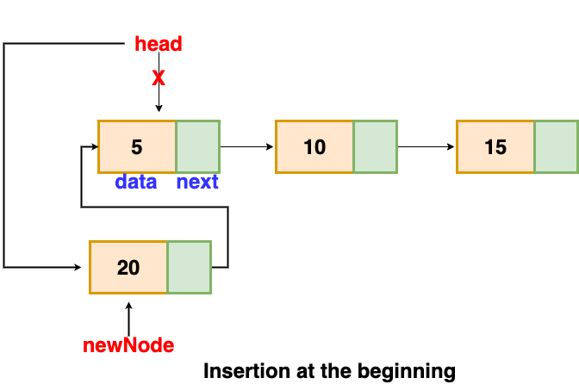
Insertion at beginning

Slide 10
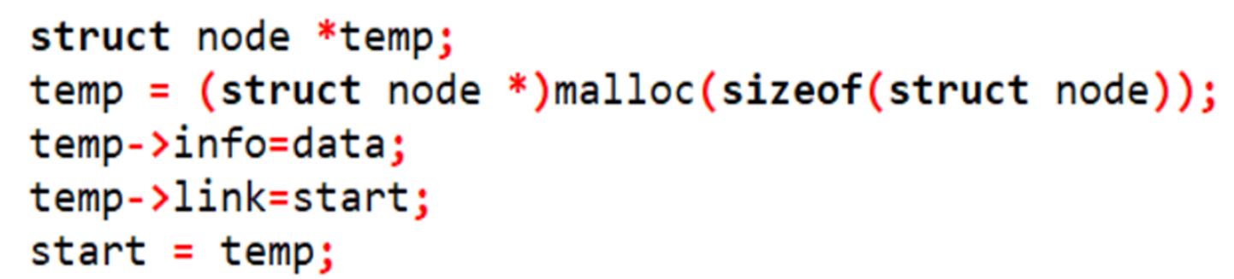
Insertion at beginning

Slide 11
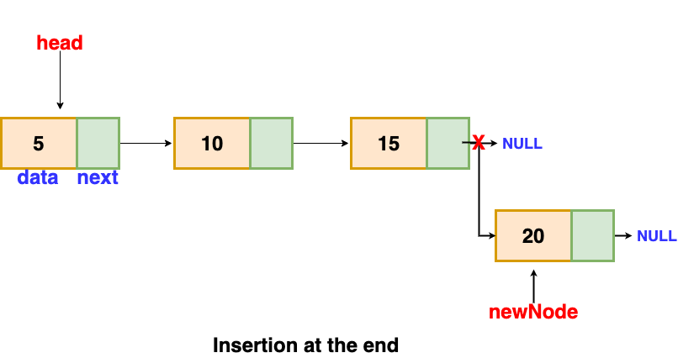
Insertion At end

Slide 12
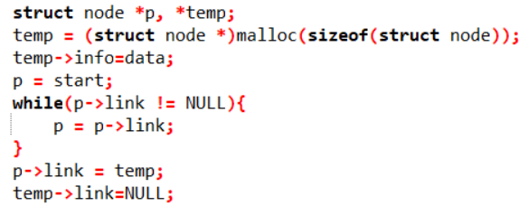
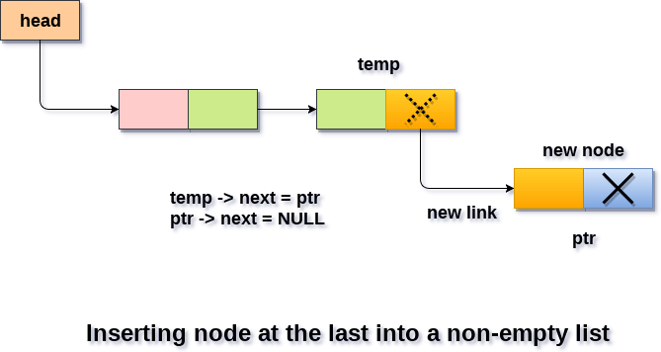
Insertion at End

Slide 13
Insertion at the specified position
OPERATION ON SINGLE LINKED LIST
To insert a new node at the specified position we have to search position in the list.
Then we can insert the node after the position. Let the address of the specified node be kept in ptr.
Adjust the pointer so that next pointer of the specified node pointed to the ptr.
The next pointer of the specified node will point to the next pointer of the node pointed by new ptr.
Notes:
13

Slide 14
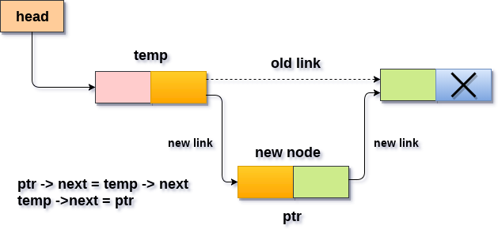
Insertion at the specified position

Slide 15
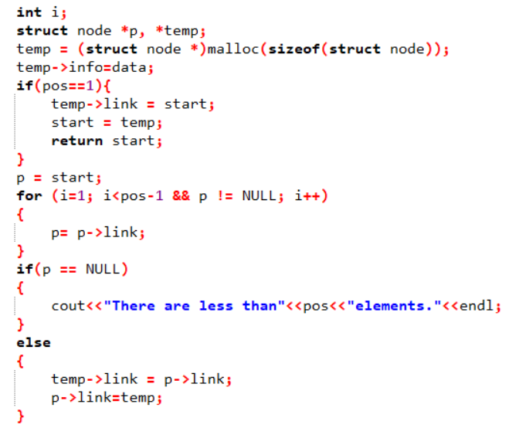
Insertion at the specified position

Slide 16
OPERATION ON SINGLE LINKED LIST
Deletion an element from the linked list
If the node be deleted, that element should be search all
over the list still the node find. Then it should be deleted.
As like as insertion the deletion is also performed in three ways.
Deletion at the beginning position of the linked list.
Deletion at the ending position of linked list.
Deletion at a specified position in linked list.
Notes:
16

Slide 17
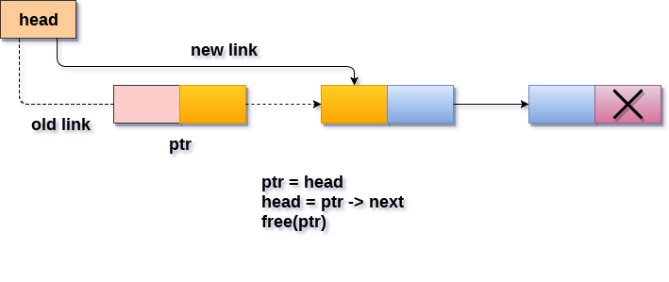
Deletion at beginning

Slide 18
Deletion at beginning
Step 1: If Start = Null then
Print: “linked list is already empty-Underflow”
Exit [End if]
Step 2: set Ptr = Start
Step 3:set Start = Start → Next
Step 4: free(Ptr)
Step 5:Exit

Slide 19
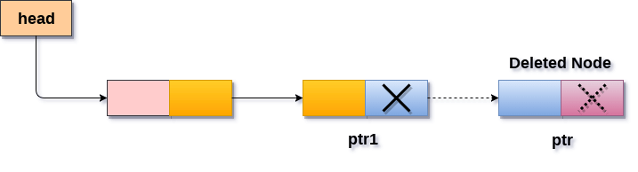
Deletion At end

Slide 20
Deletion At end
Step 1:If Start = Null Then
Print : “Linked List Empty”
Exit
[End If]
Step 2: set Ptr = Start
Step 3: Repeat steps 4 and 5 while Ptr →next != Null
Step 4: set temp = Ptr
Step 5: set Ptr = Ptr → next
[End loop]
Step 6: Set temp → next = Null
Step 7: free(Ptr)
Step 8: Exit

Slide 21
Deletion at the specified position
For deleting a particular node from the linked list, the first task is to find the address of the preceding node of nth node to be deleted.
To complete the task traverse the linked list from begin and compare the info. Stored in node with item.
Two pointers pointer1 pointer2 will be used while traversing the list for locating the address of the node to be deleted and address of it’s preceding node.

Slide 22
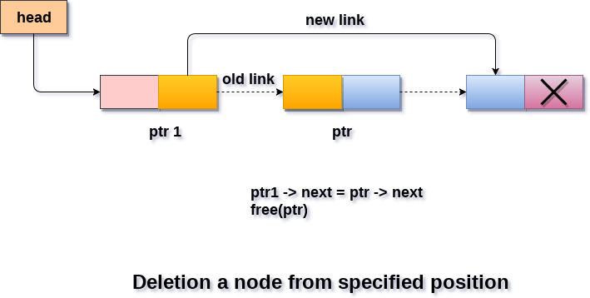
Deletion at the specified position

Slide 23
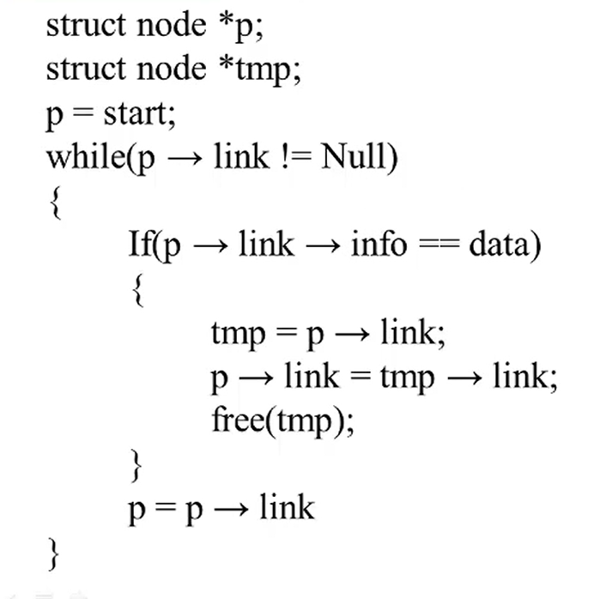
Deletion at the specified position

Slide 24
Questions?

